Slide 1
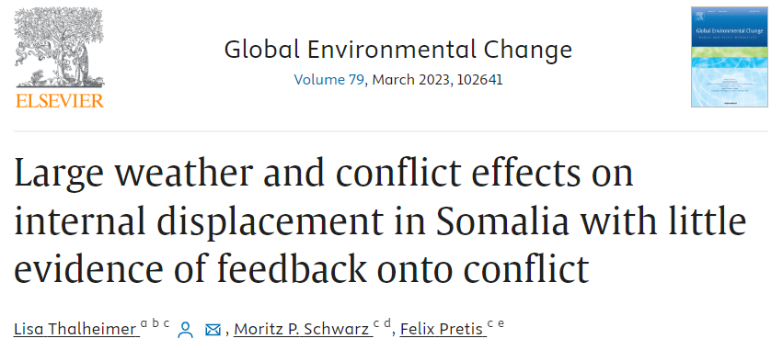

Slide 2
Key points
African drylands are particularly vulnerable to extreme weather events, which can lead to multiple interconnected challenges, including impacts on agriculture, food and water security, employment, and conflict.
Extreme weather and conflict are major drivers of internal displacement
Understanding the causal drivers of displacement is crucial for optimal allocation of aid and resources
The paper aims to quantify the interaction between extreme weather, conflict, and displacement using data from Somalia's 18 regions between 2016 and 2018.
The research provides empirical evidence on the interaction pathways of extreme weather, conflict, and displacement.

Slide 3
Data
The study uses data from the Protection and Return Monitoring Network (PRMN) survey on internal displacement in Somalia, collected by the United Nations High Commissioner for Refugees (UNHCR).
Extreme weather is measured using temperature and precipitation anomalies, sourced from the Berkeley Earth dataset for temperature and the Climate Hazards Groups Infrared Precipitation with Stations dataset (CHIRPS) for precipitation
Conflict data is sourced from the Armed Conflict Location and Event Data Project (ACLED) database, which records violent conflict events.

Slide 4
The effects of extreme weather on displacement
The study first investigated the effect of weather shocks on total displacement, considering all reported reasons for displacement.
Significant non-linear effects of temperatures on displacement were observed.
  An increase in temperatures from 1°C to 2°C is associated with a tenfold increase in predicted IDPs.
  However, a change from 0°C to 1°C only leads to close to a doubling in predicted IDPs.
A reduction from 50 mm of monthly precipitation to 0 mm leads to a fourfold increase in predicted IDPs.
The effects of weather on displacement are in agreement with other studies. These effects are even more pronounced when considering repeated drought shocks.

Slide 5
The effects of conflict on displacement
The study presents the effects of conflict events on total displacement (summed over all self-reported categories including conflict and drought) as well as for the subset of IDPs who self-reported being displaced due to conflict.
When modeling the total displacement as a function of conflict at the origin region, the study found no statistically significant effects of conflict on displacement.
The number of IDPs reporting to be displaced due to droughts masks the conflict signal. This increased noise in the data results in low statistical power to detect the effects of conflict on displacement. Currently one main reason for each movement identified is recorded during PRMN interviews, however, often the real driver for displacement may be combination of closely interrelated factors.
When focusing on the subset of IDPs who self-report being displaced due to conflict, the study found large and significant effects:
  An increase of 25 conflict events (approximately a 1.5 standard deviation increase in conflict events) compared to no conflict events in a month leads to a predicted 50-fold increase in the number of IDPs.
  This increase doubles again when considering a rise from 25 to 50 conflict events.
These results remain robust when controlling for weather shocks.
The results showed large and significant effects of conflict intensity (proxied by fatalities) on displacement.

Slide 6
Displacement effects on conflict
The paper analyses whether internally displaced persons (IDPs) arriving in a new region contribute to the conflict in that destination.
The analysis addresses two main concerns:
  Conflict Spillover Effects: There might be instances where neighboring regions experience conflict simultaneously, which could be mistakenly attributed to IDPs moving into a region.
  Reverse Causality: IDPs might choose to move to regions with low conflict, leading to potential biases in the analysis.
Despite potential biases that might overestimate the effect of displacement on conflict, the study finds no statistically significant effect of incoming IDPs on conflict.
As a robustness check, the study re-estimates the model using only in-migration driven by droughts. In fact, studying the effects of IDPs displaced due to weather on conflict could isolate the displacement effect, reducing potential spillovers through conflict channels.
The study finds no statistically significant effect of displacement on conflict at the destination, even when considering temporally lagged models that account for past displacement affecting present conflict. This holds true for models both with and without controlling for weather effects.
The results indicate that concerns about displacement leading to increased conflict, perhaps through pressures on resources, might be unfounded.

Slide 7
Findings
There are significant non-linear effects of weather on displacement.
An increase in temperature anomalies from 1°C to 2°C leads to a tenfold increase in displaced people.
A reduction in precipitation from 50 mm to 0 mm results in approximately a fourfold increase in displacement.
Conflict events also have a significant impact on displacement. A 1.5 standard deviation increase in conflict events leads to a 50-fold increase in displacement.
Testing for an effect of conflict on total displacement can mask the conflict signal. This suggests that data aggregation can lead to a misleading conclusion that conflict has no effect on displacement.
Displacement itself doesn't seem to affect the occurrence of conflict events.

Slide 8
New ideas?
Network analysis of displacements https://openknowledge.worldbank.org/server/api/core/bitstreams/2d2d931a-09c4-5b44-b1c1-67f19e3de6bd/content
Separable Temporal Exponential Random Graph Model (STERGM)
Keep linear regression model, but:
  Two-stage least-squares fixed-effect model (like Maystadt)
  Instrumental variable approach
Enlarge the area under study to neighboring countries and/or
Enlarge the time frame (they only study 2016-2018)
Go to Admin2 level
...

